Slide 1
D-Grid project: Interactive data analysis
GSI, local training, 2007-04-20
version: 0.4

Slide 2
“Road map”
Data analysis
A view from 30000 feet
Grid middleware
Implemented modules
Development process and tools

Slide 3
Data analysis
Writing from scratch for local cluster
Writing from scratch for Grid
Using PROOF:
  Preinstalled PROOF clusters (local/remote)
  Manually written PROOF job submission
Get an ALICE VO membership and use AliEn+PROOF

Slide 4
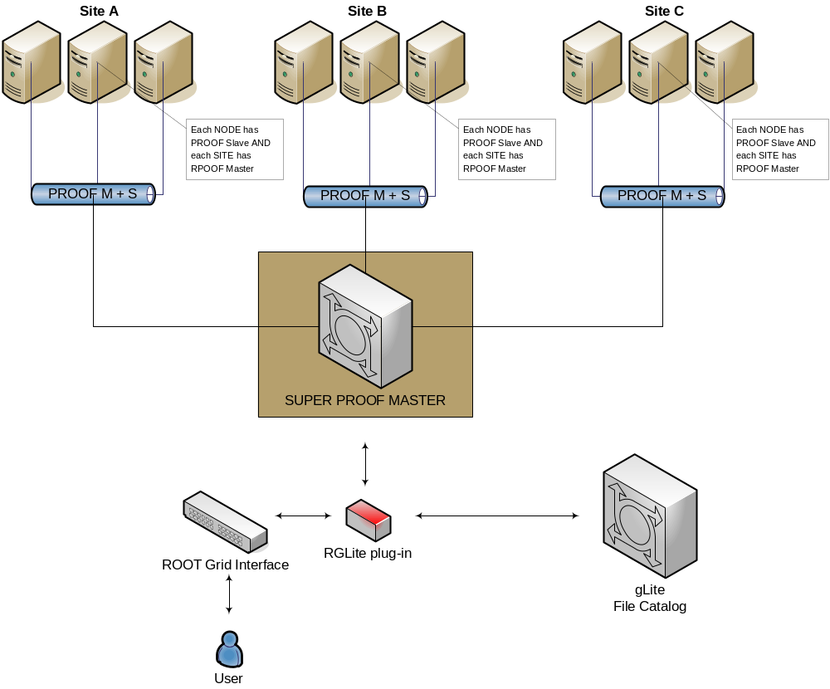
A view from 30000 feet

Slide 5
Grid middleware - gLite
We base our project on gLite Grid Middleware, since it is widely used and one of the biggest operational Grids today. gLite is a strategic Grid middleware for HEP.
The current implementation of our project is based on:
gLite WMSUI – for job submission, status querying and output retrieving;
LFC (Local LCG File Catalog) API – for file catalog operations;
GFAL (Grid File Access Library) API – for file operations on the gLite Grid.
But we also used the following components of gLite:
WMProxy – for job submission (will be used instead of WMSUI);
FiReMan – for file catalog operations;
gLite I/O server — for file operations on the gLite Grid.

Slide 6
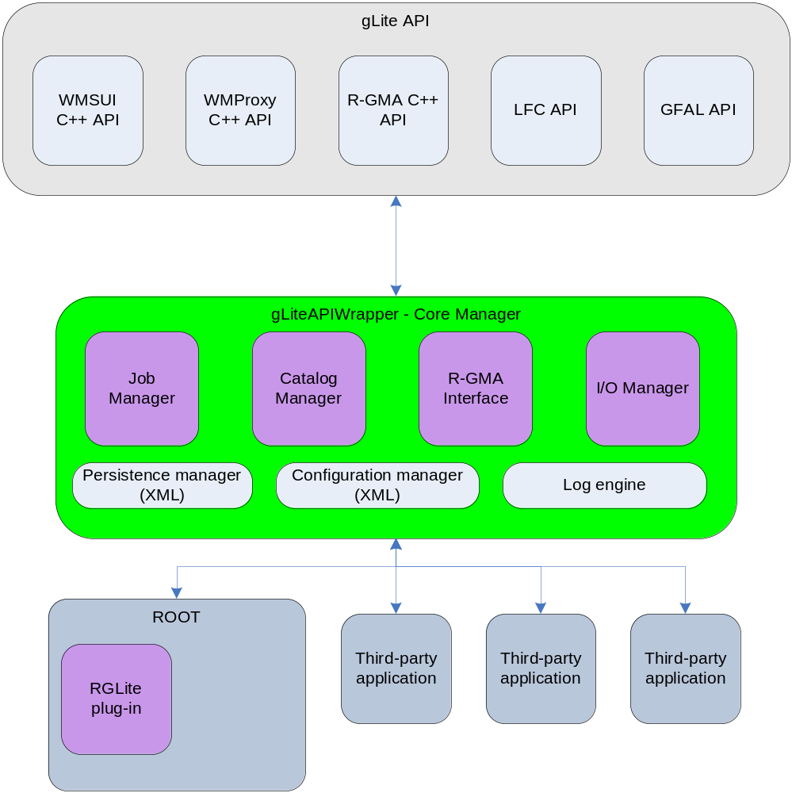
gLite-API-Wrapper
GAW Core Manager,
GAW Job Manager,
GAW Catalog Manager,
GAW Persistence Manager,
GAW Configuration Manager,
GAW Log Engine.

Slide 7
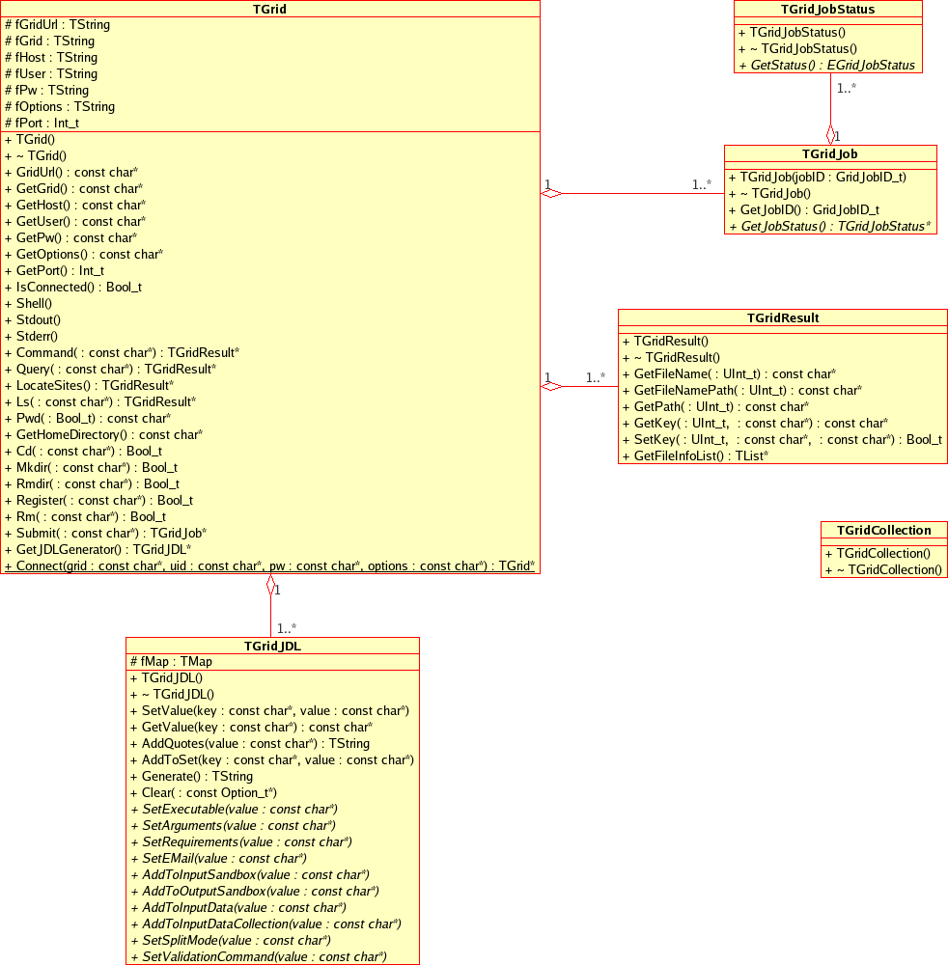

Slide 8
RGLite
Workload Management System (WMS) operations:
  job submission,
  job status querying,
  job output retrieving.
File Catalog operations:
  to set and query current working catalog directory,
  to list the content of the selected catalog directory (list files, directories and their stats),
  to create a file in a catalog namespace,
  to add replica(s) to a given file in the catalog namespace,
  to remove replica(s) from a given file in the catalog namespace,
  to remove a file or directory from a given file in the catalog namespace.
An executive logging.
Support of an external configuration.
File I/O operations could be performed with the help of TGFALFile - a ROOT class wrapper of GFAL.

Slide 9
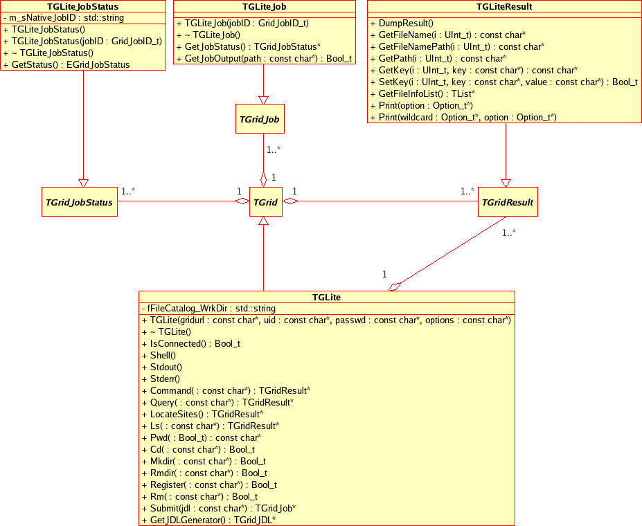

Slide 10
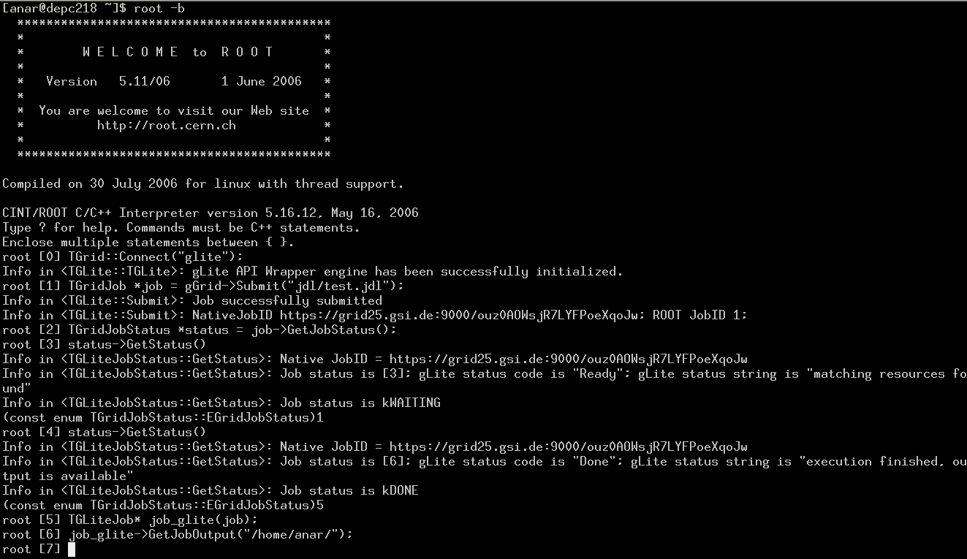
RGLite

Slide 11
RGLite Samples
// Initializing RGLite plug-in TGrid::Connect("glite"); // Submitting a Job to gLite Grid TGridJob *job = gGrid->Submit("JDLs/proofd.jdl"); // querying a Status of the Job TGridJobStatus *status = job->GetJobStatus(); status->GetStatus(); // Getting a Job's output back to the user TGLiteJob* job_glite(job); job_glite->GetJobOutput("/home/anar/");
Job submission, Status querying, Output retrieving.
// Initializing RGLite plug-in TGrid::Connect("glite"); // Changing current File Catalog directory to "dteam" gGrid->Cd("dteam"); // Querying a list of files of the current FC directory TGridResult* result = gGrid->Ls(); // Printing the list out Int_t i=0; while (result->GetFileName(i))\ > printf("File %s\n",result->GetFileName(i++));
Changing file catalog directory, querying lists of files.

Slide 12
RGLite Samples
// Initializing RGLite plug-in TGrid::Connect("glite"); // Changing current File Catalog directory to "dteam" gGrid->Cd("dteam"); // Querying a list of files of the current FC directory TGridResult* result = gGrid->Ls(); // Printing the list out, including full file information result->Print("all");
List full file information of a catalog folder.
using namespace std; // Initializing RGLite plug-in TGrid::Connect("glite"); // Changing current File Catalog directory to "dteam" gGrid->Cd("dteam"); // Printing a current working directory cout << "Working Directory is" << gGrid->Pwd() << endl; // Creating a new File Catalog Folder Bool_t b = gGrid->Mkdir("root_test2");
Retrieving a name of a current file catalog folder,
Creating a new file catalog folder.

Slide 13
PROOFAgent
PROOFAgent - a multi-functional client/server application.
It helps to use proofd on the Grid's worker nods which are behind a firewall, also PROOFAgent provides a number of additional useful functionality, which generally helps to process PROOF interactive analysis on the Grid.
TCP packet forwarding
Creates proof.conf on both client and server realms
Logging
Very configurable – xml configuration file
Supports instances
Internal protocol
Supports user commands
Could work in two modes: interactive or as a Linux daemon process
Will support encryption (on the way…)

Slide 14
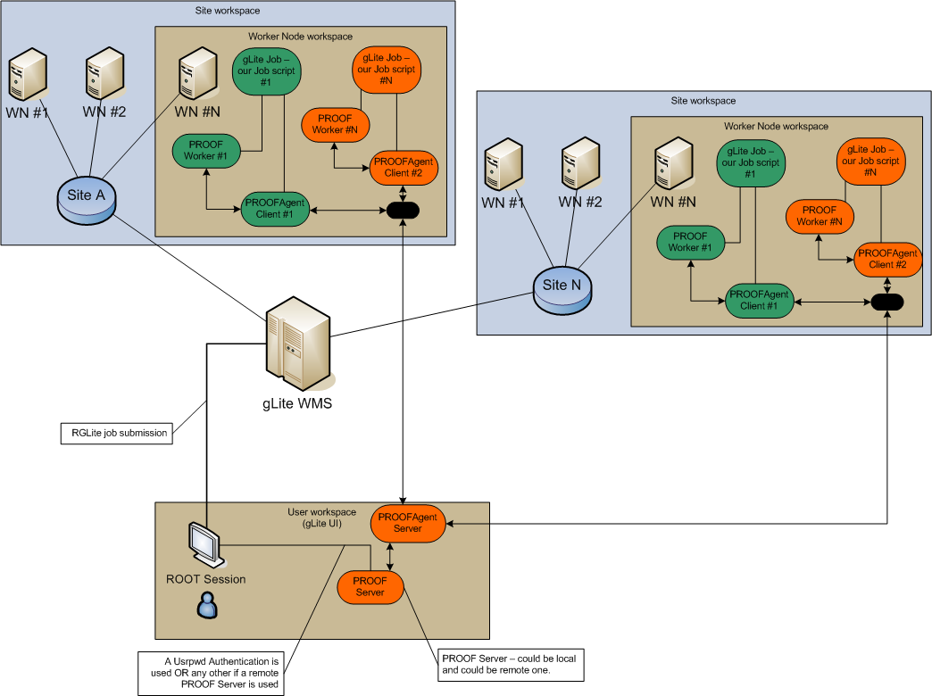

Slide 15
Development process and tools

